Slide 1
Expert Systems

Slide 2
Content
What is an Expert System?
Characteristics of an Expert System.
Classification of Expert Systems.
Components of an Expert System.
Advantages & Disadvantages of Expert Systems.
Creating an Expert System.

Slide 3
Content
What is an Expert System?
Characteristics of an Expert System.
Classification of Expert Systems.
Components of an Expert System.
Advantages & Disadvantages
Creating an Expert System.

Slide 4
Expert System
Computer software that:
  Emulates human expert
  Deals with small, well defined domains of expertise
  Is able to solve real-world problems
  Is able to act as a cost-effective consultant
  Can explains reasoning behind any solutions it finds
  Should be able to learn from experience.

Slide 5
Expert System
An expert system is a system that employs human knowledge captured in a computer to solve problems that ordinarily require human expertise.(Turban)
A computer program that emulates the behaviour of human experts who are solving real-world problems associated with a particular domain of knowledge. (Pigford & Braur)

Slide 6
What is an Expert?
  solve simple problems easily.
  ask appropriate questions (based on external stimuli - sight, sound etc).
  reformulate questions to obtain answers.
  explain why they asked the question.
  explain why conclusion reached.
  judge the reliability of their own conclusions.
  talk easily with other experts in their field.
  learn from experience.
  reason on many levels and use a variety of tools such as heuristics, mathematical models and detailed simulations.
  transfer knowledge from one domain to another.
  use their knowledge efficiently

Slide 7
Expert System
Expert Systems manipulate knowledge while conventional programs manipulate data.
An expert system is often defined by its structure.
Knowledge Based System Vs Expert System

Slide 8
ES Development
Problem Definition.
System design…(Knowledge Acquisition).
Formalization. (logical design,,,,, tree structures)
System Implementation. (building a prototype)
System Validation.

Slide 9
Content
What is an Expert System?
Characteristics of an Expert System.
Classification of Expert Systems.
Components of an Expert System.
Advantages & Disadvantages
Creating an Expert System.

Slide 10
Content
What is an Expert System?
Characteristics of an Expert System.
Classification of Expert Systems.
Components of an Expert System.
Advantages & Disadvantages
Creating an Expert System.

Slide 11
Characteristics of Expert System
Pigford & Baur
Inferential Processes
  Uses various Reasoning Techniques
Heuristics
  Decisions based on experience
  and knowledge

Slide 12
Characteristics (cont…)
Waterman
ability to manipulate
concepts and symbols
ability to explain how
conclusions are made
ability to extend
and infer knowledge
Perform at least to the
same level as an expert
Expertise
Depth
Symbolic Reasoning
Self Knowledge

Slide 13
Knowledge and Uncertainty
Facts and rules are structured into a knowledge base and used by expert systems to draw conclusions.
There is often a degree of uncertainty in the knowledge.
  Things are not always true or false
  the knowledge may not be complete.
In an expert system certainty factors are one way indicate degree of certainty attached to a fact or rule.

Slide 14
Content
What is an Expert System?
Characteristics of an Expert System.
Classification of Expert Systems.
Components of an Expert System.
Advantages & Disadvantages
Creating an Expert System.

Slide 15
Content
What is an Expert System?
Characteristics of an Expert System.
Classification of Expert Systems.
Components of an Expert System.
Advantages & Disadvantages
Creating an Expert System.

Slide 16
Classification of Expert System
Classification based on “Expertness” or Purpose
Expertness
    used for routine analysis and points out those portions of the work where the human expertise is required.
    the user talks over the problem with the system until a “joint decision” is reached.
    the user accepts the system’s advice without question.
An assistant
A colleague
A true expert

Slide 17
Content
What is an Expert System?
Characteristics of an Expert System.
Classification of Expert Systems.
Components of an Expert System.
Advantages & Disadvantages
Creating an Expert System.

Slide 18
Content
What is an Expert System?
Characteristics of an Expert System.
Classification of Expert Systems.
Components of an Expert System.
Advantages & Disadvantages
Creating an Expert System.

Slide 19
Components of an Expert System
Expert System
Knowledge
Base
User
Interface
Inference
Engine
User

Slide 20
Content
What is an Expert System?
Characteristics of an Expert System.
Classification of Expert Systems.
Components of an Expert System.
Advantages & Disadvantages
Creating an Expert System.

Slide 21
Content
What is an Expert System?
Characteristics of an Expert System.
Classification of Expert Systems.
Components of an Expert System.
Advantages & Disadvantages
Creating an Expert System.

Slide 22
Desirable Features of an Expert System
Dealing with Uncertainty
  certainty factors
Explanation
Ease of Modification
Transportability
Adaptive learning

Slide 23
Advantages
Capture of scarce expertise
Superior problem solving
Reliability
Work with incomplete information
Transfer of knowledge

Slide 24
Limitations
Expertise hard to extract from experts
  don’t know how
  don’t want to tell
  all do it differently
Knowledge not always readily
available
Difficult to independently
validate expertise

Slide 25
Limitations (cont…)
High development costs
Only work well in narrow domains
Can not learn from experience
Not all problems are suitable

Slide 26
Content
What is an Expert System?
Characteristics of an Expert System.
Classification of Expert Systems.
Components of an Expert System.
Advantages & Disadvantages
Creating an Expert System.

Slide 27
Content
What is an Expert System?
Characteristics of an Expert System.
Classification of Expert Systems.
Components of an Expert System.
Advantages & Disadvantages
Creating an Expert System.

Slide 28
Creating an Expert System
Two steps involved:
1. extracting knowledge and methods from the
expert (knowledge acquisition)
2. reforming knowledge/methods into an
organised form (knowledge representation)

Slide 29
Acquiring the Knowledge
What is knowledge?
Data:
  Raw facts, figures, measurements
Information:
  Refinement and use of data to answer specific question.
Knowledge:
  Refined information

Slide 30
Sources of Knowledge
documented
  books, journals, procedures
  films, databases
undocumented
  people’s knowledge and expertise
  people’s minds, other senses

Slide 31
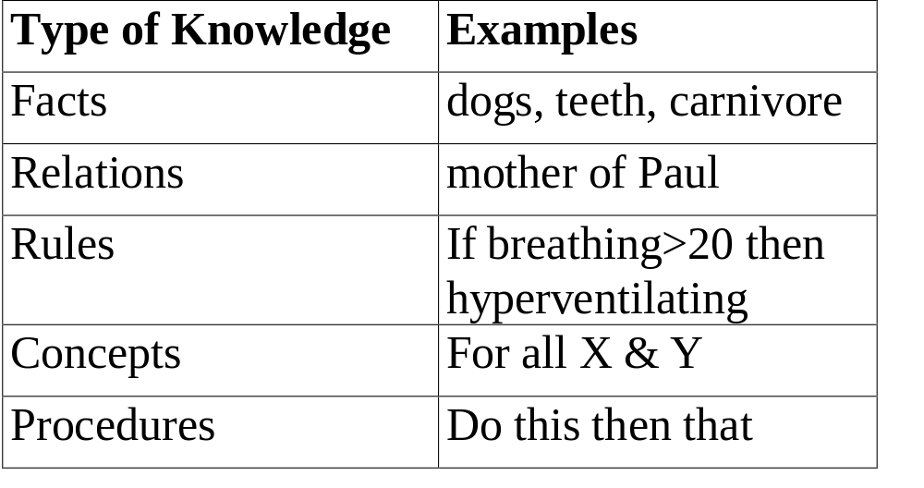
Types Knowledge

Slide 32
Levels of Knowledge
Shallow level:
  very specific to a situation Limited by IF-THEN type rules. Rules have little meaning. No explanation.
Deep Knowledge:
  problem solving. Internal causal structure. Built from a range of inputs
  emotions, common sense, intuition
  difficult to build into a system.

Slide 33
Categories of Knowledge
Declarative
  descriptive, facts, shallow knowledge
Procedural
  way things work, tells how to make inferences
Semantic
  symbols
Episodic
  autobiographical, experimental
Meta-knowledge
  Knowledge about the knowledge

Slide 34
Good knowledge
Knowledge should be:
  accurate
  nonredundant
  consistent
  as complete as possible
  (or certainly reliable enough
  for conclusions to be drawn)

Slide 35
Knowledge Acquisition
Knowledge acquisition is the process by which knowledge available in the world is transformed and transferred into a representation that can be used by an expert system. World knowledge can come from many sources and be represented in many forms.
Knowledge acquisition is a multifaceted problem that encompasses many of the technical problems of knowledge engineering, the enterprise of building knowledge base systems. (Gruber).

Slide 36
Knowledge Acquisition
Five stages:
Identification: - break problem into parts
Conceptualisation: identify concepts
Formalisation: representing knowledge
Implementation: programming
Testing: validity of knowledge

Slide 37
Organizing the Knowledge
Knowledge Engineer
  Interacts between expert and Knowledge Base
  Needs to be skilled in extracting knowledge
  Uses a variety of techniques

Slide 38
Knowledge Acquisition
The basic model of knowledge acquisition requires that the knowledge engineer mediate between the expert and the knowledge base. The knowledge engineer elicits knowledge from the expert, refines it in conjunction with the expert and represents the knowledge in the knowledge base using a suitable knowledge structure.
Elicitation of knowledge done either manually or with a computer.

Slide 39
Knowledge Acquisition
Manual:
  interview with experts.
  structured, semi structured, unstructured interviews.
  track reasoning process and observing.
Semi Automatic:
  Use a computerised system to support and help experts and knowledge engineers.
Automatic:
  minimise the need for a knowledge engineer or expert.

Slide 40
Knowledge Acquisition Difficulties
    Knowledge is not easy to acquire or maintain
    More efficient and faster ways needed to acquire knowledge.
    System's performance dependant on level and quality of knowledge "in knowledge lies power.”
    Transferring knowledge from one person to another is difficult. Even more difficult in AI. For these reasons:
      expressing knowledge
      The problems associated with transferring the knowledge to the form required by the knowledge base.

Slide 41
Other Problems
Other Reasons
  experts busy or unwilling to part with knowledge.
  methods for eliciting knowledge not refined.
  collection should involve several sources not just one.
  it is often difficult to recognise the relevant parts of the expert's knowledge.
  experts change

Slide 42
Organizing the Knowledge
Representing the knowledge
  Rules
  Semantic Networks
  Frames
  Propositional and Predicate Logic

Slide 43
Representing the Knowledge
Rules
If
pulse is absent and breathing is absent
Then
person is dead.

Slide 44
Representing the Knowledge
Semantic Networks
Owns
Sam
Car
Is a
Honda
Colour
Made in
Green
Japan

Slide 45
Representing the Knowledge
Frames
based on objects
objects are arranged in a hierarchical manner
Frame Name
Vacation
Where
Albury
When
March
Cost
$1000

Slide 46
Representing the Knowledge
Propositional & Predicate Logic
based on calculus
J = Passed assignment
K = Passed exam
Z = J and K
Student has passed assignment and passes exam

